Slide 1
Classification approaches

Slide 2
Classification approaches SOA
TABLEAU COMPARATIVE
 | Machine Learning | Clustering | Deep learning | Ensemble Learning | Pertained Models
Preprocessing |  |  | (Data augmentation) |  | ???
Segmentation |  |  | X | Depend on models used | ???
Feature extraction and selection |  |  | X | Depend on models used | ???
Model building |  |  |  |  | ???
Model training |  | X

Slide 3
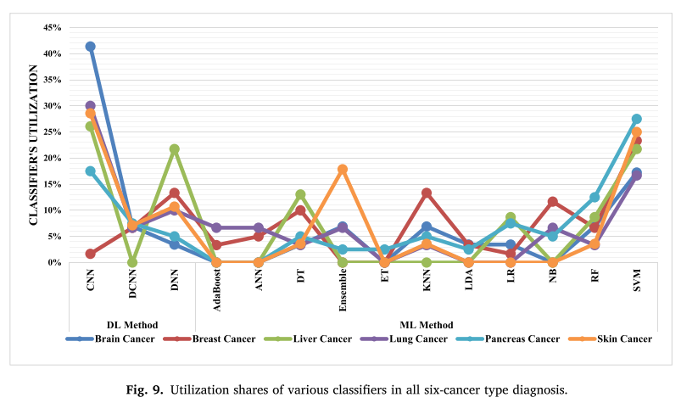
Deeplearning vs traditional AI
DL AI
INPUT
OUTPUT
requires a lot of data.
high abstraction about output/features (need more research) .
Computationally complexes and expensive.
CNN models generate high-precision output and are eﬃcient in
solving complex problems. They can be applied using diﬀerent mathe-
matical learning methods [11].

Slide 4
Comparaison de performance
Reference | Methods | Dataset | Accuracy (%) | Sensitivity (%) | Specificity (%)
[31] | DCNN | PH2 | 95.00 | 93.00 | 95.00
 |  | ISIC 2017 | 95.00 | 97.00 | 96.00
[28] | AlexNet, VGG16 | PH2 | 97.50 | 100 | 96.87
[32] | FCNs based on VGG16 and GoogleNet | ISBI 2016 | 88.92 | 69.33 | 93.75
[33] | Deep RCNN and Fuzzy C-Mean Clustering | ISBI 2016 | 94.20 | 95.00 | 94.00
[34] | DenseNet with IcNR | ISBI 2017 | 93.40 | 93.00 | –
[35] | Optimized CNN | DermIS + Dermquest | 93.00 | 99.40 | 94.00
[35] | Transfer learning and pre-trained deep neural net | MED-NODE | 97.70 | 97.30 | 97.40
[36] | Ensemble–ResNet and Inception V3 | ISBI 2018 | 89.00 | 86.20 | 79.60
[22] | LDA with CNN | ISBI 2017 | 85.80 | 52.00 | 97.40
[37] | CNN and Novel Regularizer | ISIC Archive | 97.49 | 94.30 | 93.60

